Slide 1

We are introducing you
Access Point Mapper
MapMyWifi

Slide 2

The first mobile application designed to simplify Wi-Fi planning and proposal processes.

Slide 3
Connecting ISP and Customers
Intended Audience
-ISP (Internet Service Providers)
-Regular users who need to get internet

Slide 4
Spending too much time to get an estimate
Problem
On average it takes 1 week to get a proposal for the internet. Because it requires to map access points for full coverage and optimization.

Slide 5
Mobile Proposal and Estimate Maker:
-Save labor costs by automating access point placement and cost estimation.
-Improve accuracy and efficiency with optimized Wi-Fi planning.
-Attract more customers with faster quotes and competitive pricing.
Solution

Slide 6
Features
Instant Cost Estimation and Tailored Plan Suggestions
Provides immediate estimates for Wi-Fi setup costs and creates multiple plan options catering to diverse customers.
Automated Access Point Placement
Automatically suggests optimal access point locations on floorplans.
01
02
Customization
Ability to move the access points and test and switch with different model.
03
04
Simple Interface
A clean, intuitive interface that makes Wi-Fi planning accessible/simple to all users.

Slide 7

Timeline
.
01
Initiation
Research, Planning and Task distribution.
1 weeks
02
Tech Analyzing
Donec ornare rutrum neque sit amet pellentesque. Nulla eget dictum tortor.

Slide 8
01
Start Here
Donec ornare rutrum neque sit amet pellentesque. Nulla eget dictum tortor.
g
Timeline.
02
Designing
UI design, Data Base Structure modelling.
1 weeks
03
Creation Process
Donec ornare rutrum neque sit amet pellentesque. Nulla eget dictum tortor.
s

Slide 9
02
Tech Analyzing
Donec ornare rutrum neque sit amet pellentesque. Nulla eget dictum tortor.
g
Timeline.
03
Development
Coding and Coding, API documentation.
4 weeks
04
Test Process
Donec ornare rutrum neque sit amet pellentesque. Nulla eget dictum tortor.
d

Slide 10
03
Creation Process
Donec ornare rutrum neque sit amet pellentesque. Nulla eget dictum tortor.
s
Timeline
04
Testing
Debugging.
1 weeks
05
Launching

Slide 11
06
Option Six
Donec ornare rutrum neque sit amet pellentesque. Nulla eget dictum tortor.
Timeline
05
Launching
3 days

Slide 12
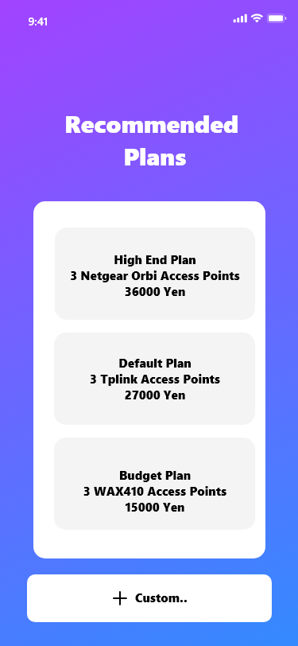

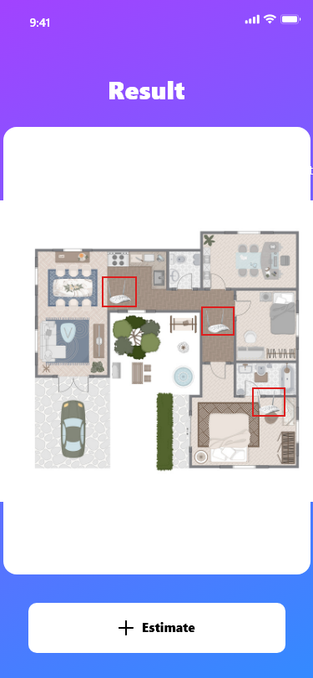

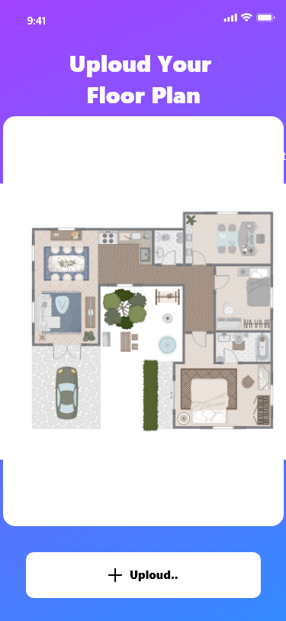

Mock UI

Slide 13
Monetization Plan
(But free is always good)
Commission
Whenever a customer signs up for a plan we get a commission from the Internet Provider.
40%
60%
Ads
Commission
Ads
Banner ads

Slide 14
Get Ready For
MapMyWifi
https://unsplash.com/photos/lvJZhHOIJJ4

